Slide 1


Slide 2
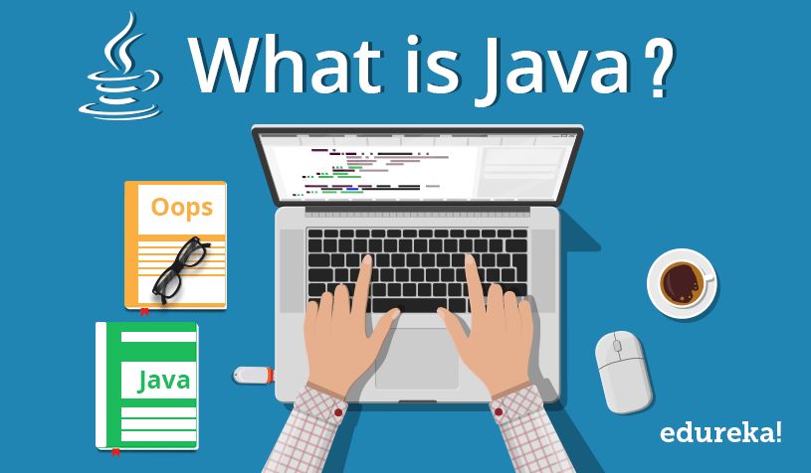
Java is an object oriented programming language.
It is a high-level language that is easy to read and understand.

Slide 3

WHY JAVA INVENTED
The Java programming language originated as part of a research project to develop advanced software for a wide variety of network devices and embedded systems.
The goal was to develop a small, reliable, portable, distributed, real-time operating platform.

Slide 4

WHO INVENTED JAVA
Java was developed by Sun Microsystems (which is now the subsidiary of Oracle) in the year 1995.
James Gosling is known as the father of Java.
Before Java, its name was Oak.
Since Oak was already a registered company, so James Gosling and his team changed the name from Oak to java.

Slide 5
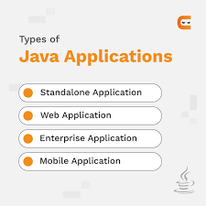

Slide 6
JAVA EDITIONS AND VERSIONS
There are 4 editions of java
Java SE (Java Standard Edition):
This editions contains four libraries
like java.lang,java.util etc.,
2) Java EE (Java Enterprise Edition):
It is an enterprise platform that is mainly used to develop web and enterprise applications.
Like APIs,jsp,servlets etc.,
3) Java ME (Java Micro Edition):
It is a micro platform that is dedicated to mobile applications.
4)Java FX:
It is used to develop rich internet applications. It uses a lightweight user interface API.

Slide 7
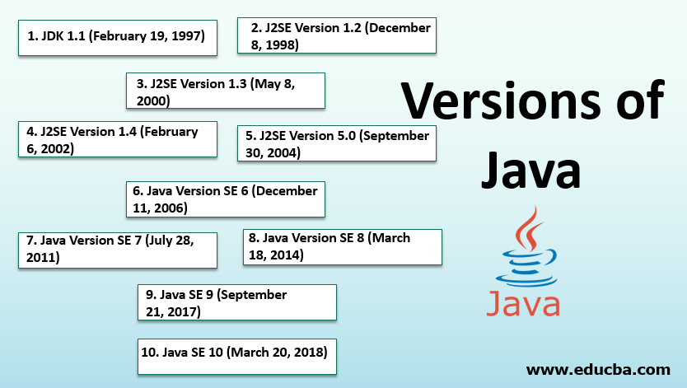

Slide 8
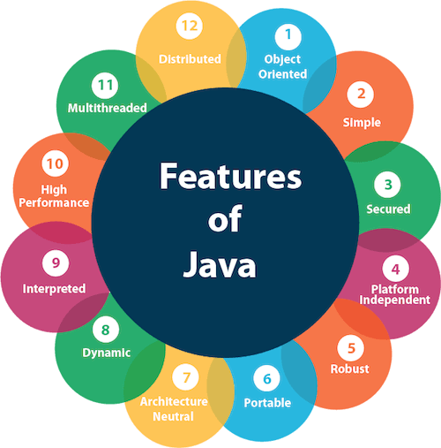
ssimpl

Slide 9
JAVA SOFTWARE
JDK:
The java development kit(JDK)is a software development environment which is used to develop java applications and applets.
It contains JVM+JRE
JRE:
It is a set of s/w tools which are used for developing java applications.
It is used to provide the runtime environment.
JVM:
It is a specification that provides a runtime environment in which java bytecode can be executed.

